Slide 1

Process Mining Internship
by
GONA LIKITHA
Roll No. 204G1A3247
Department of Computer Science and Engineering (Data Science)
Srinivasa Ramanujan Institute of Technology
(Affiliated to JNTUA & Approved by AICTE) (Accredited by NAAC with ‘A’ Grade & Accredited by NBA (EEE, ECE & CSE)
Rotarypuram Village, B K Samudram Mandal, Ananthapuramu – 515701.
2023 - 2024

Slide 2

Contents
Course Objective
Introduction
Technology
Applications
Modules
Real Time applications
Learning outcomes
GitHub Link
Queries

Slide 3
Course Objective
Introduction to Process Mining: To develop the skills necessary for a career in process mining, such as data analysis, problem-solving, and communication.
Process Mining Techniques: Gain hands-on experience with a process mining tool.Apply process mining to real-world business problems.Understand the different types of process mining techniques and how to apply them.
You will learn how to use process mining tools to collect data, build process models, and identify opportunities for improvement.
Learn the fundamentals of process mining, including process discovery, conformance checking, and performance analysis.

Slide 4
Introduction
Process mining is a data-driven approach that uncovers insights from event data recorded in digital systems, revealing the true sequence of activities, decisions, and interactions within business processes.
Here's an introduction to the key concepts of process mining:
Data Source
Event Logs
Visualization
Process Discovery

Slide 5
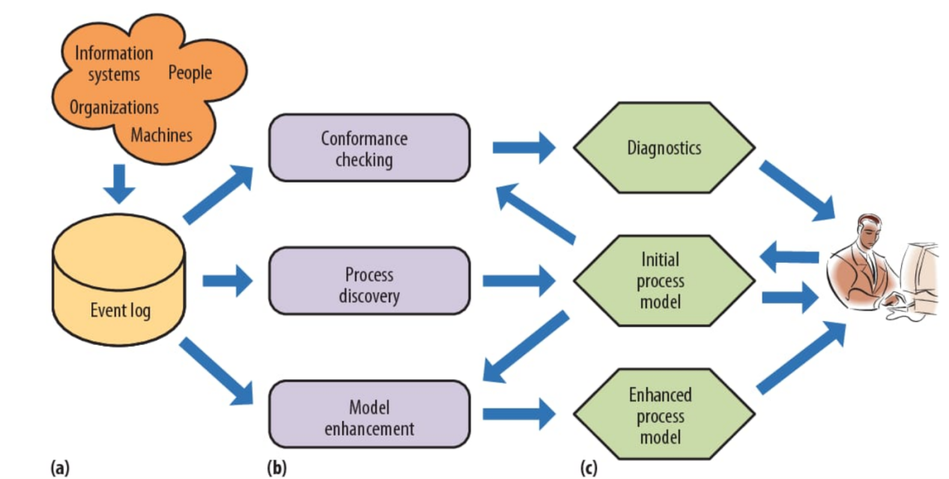
How Process Mining Works

Slide 6
Continuation..
Data Collection: The first step involves collecting event data from various sources such as enterprise software systems, databases, and logs.
Event Log : The collected event data is organized into event logs. Each event log contains a chronological sequence of events related to one or more process instances. A process instance refers to the execution of a process from start to finish.
Process Discovery: process mining algorithms analyze the event logs to create process models. These models visualize the sequence of activities, decisions, and their relationships as a process flow. There are several techniques for process discovery, including alpha-algorithm, heuristic mining.

Slide 7
Continuation..
Model Enhancement : With insights gained from the process models and performance analysis, organizations can make informed decisions about how to optimize their processes. This could involve redesigning parts of the process, reallocating resources, or redefining specific procedures to improve efficiency and effectiveness.
Initial Process Modal:The initial process model in process mining is the first representation of a business process based on observed event data. It captures the actual flow of activities as they occurred in reality, providing a starting point for analysis and improvement.

Slide 8

History of Process Mining
Professor Wil van der Aalst is widely considered the "godfather" of process mining. He is the author of the seminal book "Process Mining: Data Science in Action" and is considered one of the world's leading experts in process mining.
In 2003, Professor van der Aalst published his first paper on process mining, which introduced the concept of process discovery
In 2021, Professor van der Aalst was appointed Chief Scientist at Celonis, the leading process mining software company.

Slide 9

Technology
Process mining employs various technologies to analyze event data and derive insights.
Data Extraction and Integration Tools
Process models
Process mining algorithms
Natural language processing

Slide 10
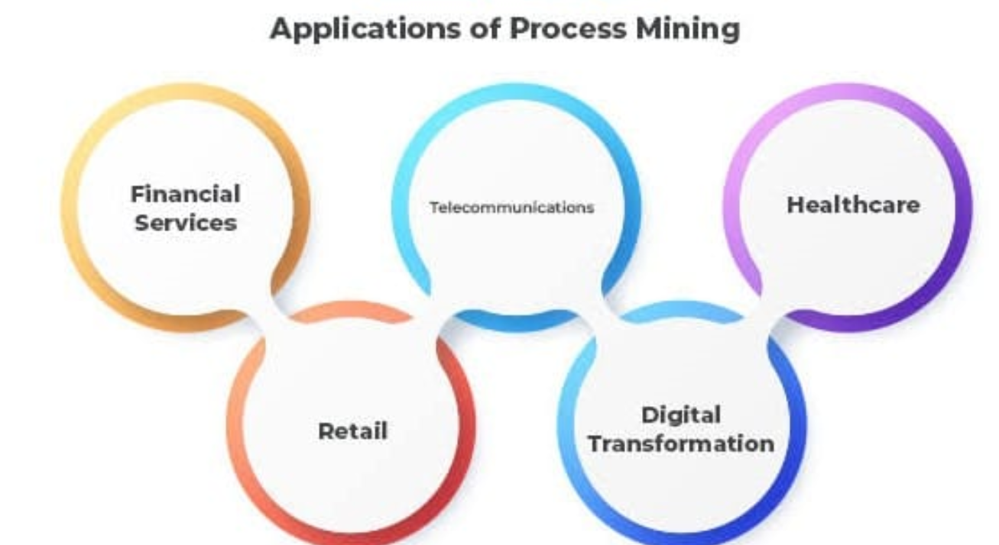
Applications
Process mining finds applications across various industries and sectors due to its
ability to uncover valuable insights from event log data. Here are some key
applications of process mining:
Healthcare
Manufacturing
Retail
Banking
Telecommunication

Slide 11
Modules
Process Mining LifeCycle
Benefits of Process Mining

Slide 12
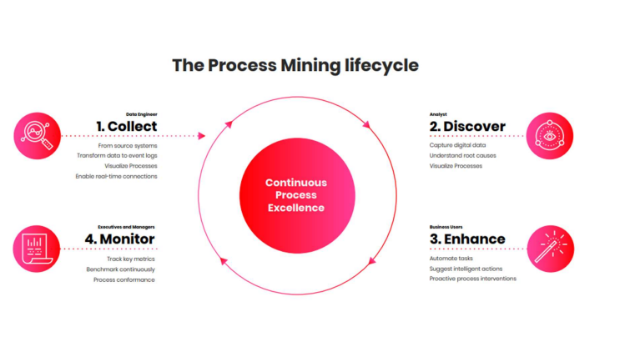
Process Mining LifeCycle
The four stages of Process Mining:
Collect: The first stage of Process Mining is for data engineers to establish a real-time link to those key data sources, extract that raw data and turn it into an eventlog.
Discover:In the second stage of Process Mining, data analysts methodically quanlity the sum total of your process environment: every case, pathway, variation.
Enhance:In the third stage of Process Mining business users leverage AI and machinelearning models to execute these enhancement actions across all relevant transactional systems within the same Process Mining interface.
Monitor:In the fourth stage of Process Mining, executives and managers measure and monitor process performance toward KPIs and business outcomes.

Slide 13
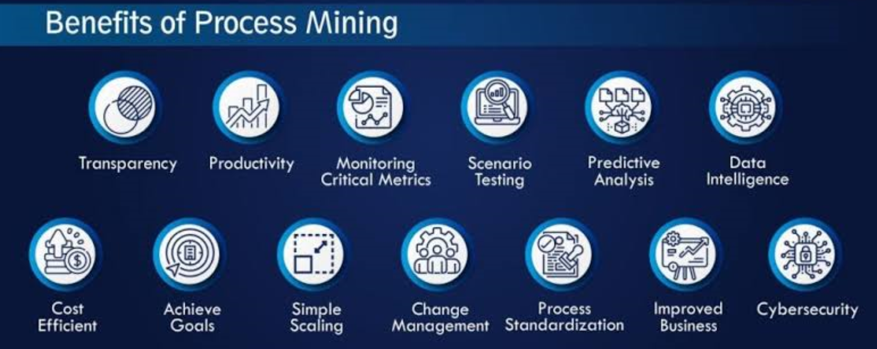
Benifits of Process Mining
Process mining is a data science discipline that discovers, analyzes, and improves real-world processes by extracting knowledge from event logs. It can be used to gain insights into the current state of a process, identify areas for improvement, and track the impact of changes.
Improved process efficiency
Reduced costs
Increased compliance
Improved customer experience

Slide 14

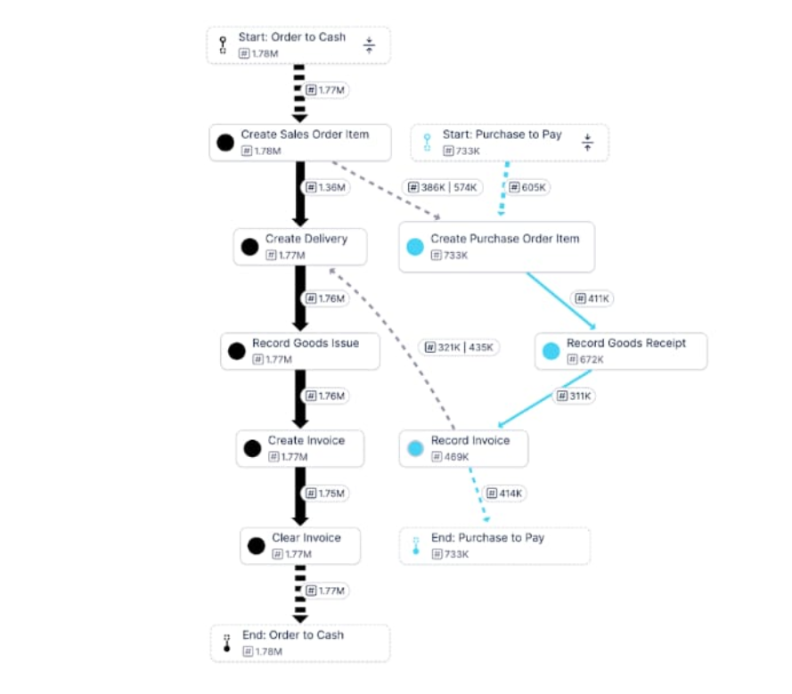
Real Time applications
Business

Slide 15
Outcomes
By the end of the process mining virtual internship with Celonis, participants should have a comprehensive understanding of process mining concepts, hands-on proficiency in using the Celonis platform, and the ability to apply process mining techniques to real-world scenarios for process improvement and optimization.
Gaining a deeper understanding of process mining: The internship will provide the student with a comprehensive understanding of the principles and practices of process mining. This includes learning about the different types of process mining, the tools and techniques used, and the benefits of process mining.
The key skills and knowledge that were gained, such as how to use process mining tools, how to analyse process data, and how to identify and prioritize improvement opportunities.

Slide 16
Conclusion
In conclusion, I have learned a lot about how to use process mining tools to analyze and process the data and to identify and prioritize improvement opportunities. I have also learned about the challenges of implementing process mining in organizations.
The key skills and knowledge that were gained, such as how to use process mining tools, how to analyze processed data, and how to identify and detect the unwanted actions included in process.

Slide 17
References
1. Website www.processmining.org
2. Website www.habrahabr.ru/post/244879/,article Introduction in Process Mining
3. Burattin Andrea. Applicability of Process Mining techniques in Business Environments
4. D.Harel and R.Marelly. Come, Let’s play: Scenari-Based Programming Using LSCs and Play-Engine. Springer, Berlin, 2003.
Celonis: Ultimate Guide to Process Mining: https://www.celonis.com/ultimate-guide/
Celonis: The State of Process Excellence: https://www.celonis.com/report/state-of-process/read/
Celonis: The Process Mining Buyer’s Guide: https://www.celonis.com/ebook/process-mining-buyers-guide/
Celonis: Process Mining for Procure-to-Pay: https://www.celonis.com/ebook/procure-to-pay-process/?utm_campaign=process_mining

Slide 18
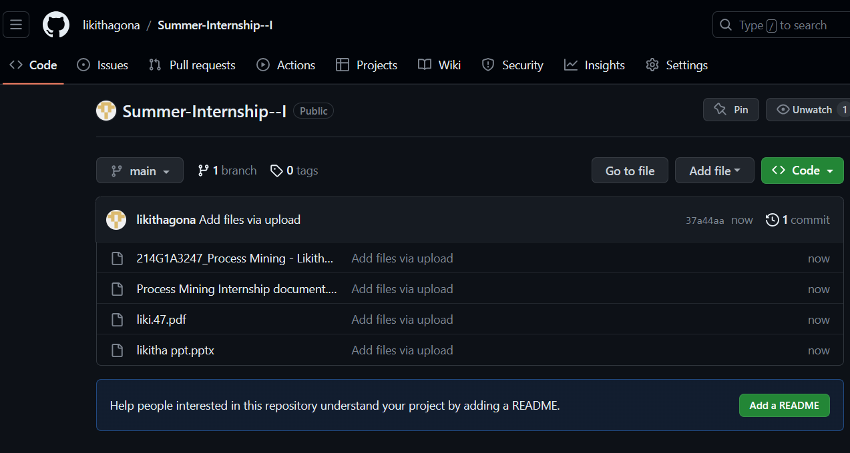
Git Hub Dashboard
Repository Name Like: Summer Internship - I
https://github.com/likithagona/Summer-Internship--I

Slide 19
Any Queries?

Slide 20
Thank You!!!

